Slide 1


Hospital Facilities Catalog (Milestone 2.0)
Team Kanto: Eva Mui, David Merten-Jones, Aashish Sunar, Jennifer Long, Aishwarya Pandian

Slide 2
Agenda
01 | Project Background
02 | User Stories (Milestone 2.0)
03 | Demo – Application
04 | Test Strategies
05 | Project Plan and Methodology
06 | Lesson Learned

Slide 3
Project Background

Slide 4
Background
A centralized web application for discovering healthcare services.
Assists hospitals with publishing information about the medical services provided in their facility.
Helps patients find medical care quickly.
Allows administrators to manage and update facility service listings.
Helps hospital or clinic administrators to keep service listings up to date to support informed user decisions
Allow patients to share feedback and drive hospital improvements through transparency

Slide 5
User Stories & Acceptance Criteria
(Milestone 2.0)

Slide 6
User Story 4
As an IT administrator or application support team member, I want the ability to create and manage user accounts and assign role-specific access to services, configurations, settings, and tools so that users have the appropriate permissions.
Acceptance Criteria
Administrators
Provide administrators with a centralized interface to create, edit, and delete user accounts.
Allow administrators to assign predefined roles - user, provider or admin
Customize permissions for specific users to ensure providers and patients cannot access the administrative interface or its functions.
Users
The users should be able to sign-in and create an account.
Limit visibility so each user only sees and interacts with features and information relevant to their role.
Future Updates
Include audit logging and activity tracking to keep track of changes to user accounts and permissions to bolster security and HIPAA compliance requirements.

Slide 7
User Story 5
As a hospital or clinic administrator, I want to add, update, or remove the services offered by my facility so that the information remains accurate and up to date for users.
Acceptance Criteria
As the Hospital / Healthcare Provider
Create a user-friendly interface for the hospital to update or edit new services, including details such as name of service, a brief description, hours of operation, and associated departments.
Allow categorization of services to help users quickly find relevant services.
As the Administrator
Allow administrators to help with updating service information such as availability, staffing changes, or procedural updates, to ensure accuracy.
Limit visibility and accessibility so each user only sees and interacts with features and information relevant to their role.
Future Updates
Any changes made to the services should be reflected in real time across the system.
Expansion of categories of services provided

Slide 8
User Story 6
As a patient, I want to view and submit ratings and feedback for services I’ve received so I can share my experience with other patients and provide input to the hospital for improvement.
Acceptance Criteria
Provide a clear and user-friendly review submission interface for feedback submission.
Enable patients to write their own reviews and ratings for the services they received and allow them to share their experiences directly with other users.
Limit visibility and accessibility so each user only sees and interacts with features and information relevant to their role.
Future Updates
Relocate the “Leave Review” button from the user interface to the individual hospital’s page for better context and usability, while maintaining existing functionality.
Ensure patient feedback is visible to hospital administrators so they can identify areas for improvement and track patient satisfaction trends.
Allow patients to view ratings and feedback submitted by others so they can make informed decisions about services.

Slide 9
Demo
Application

Slide 10
Test Strategies

Slide 11
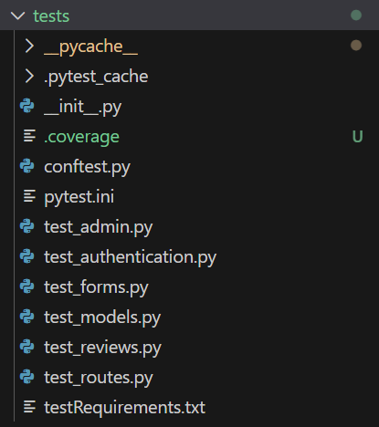
Pytest
Final test suite consists of unit (models and forms), integration (authentication and database operations), and functional tests (user workflows).
Implementing account type presented a new problem:
Role-based Access Control
  Admin panel can be accessed only by admins
  Service update function can only be accessed by admins and providers
  Reviews can only be submitted by patients
  Reviews can only be managed by admins
We approached this problem through authentication flows.

Slide 12
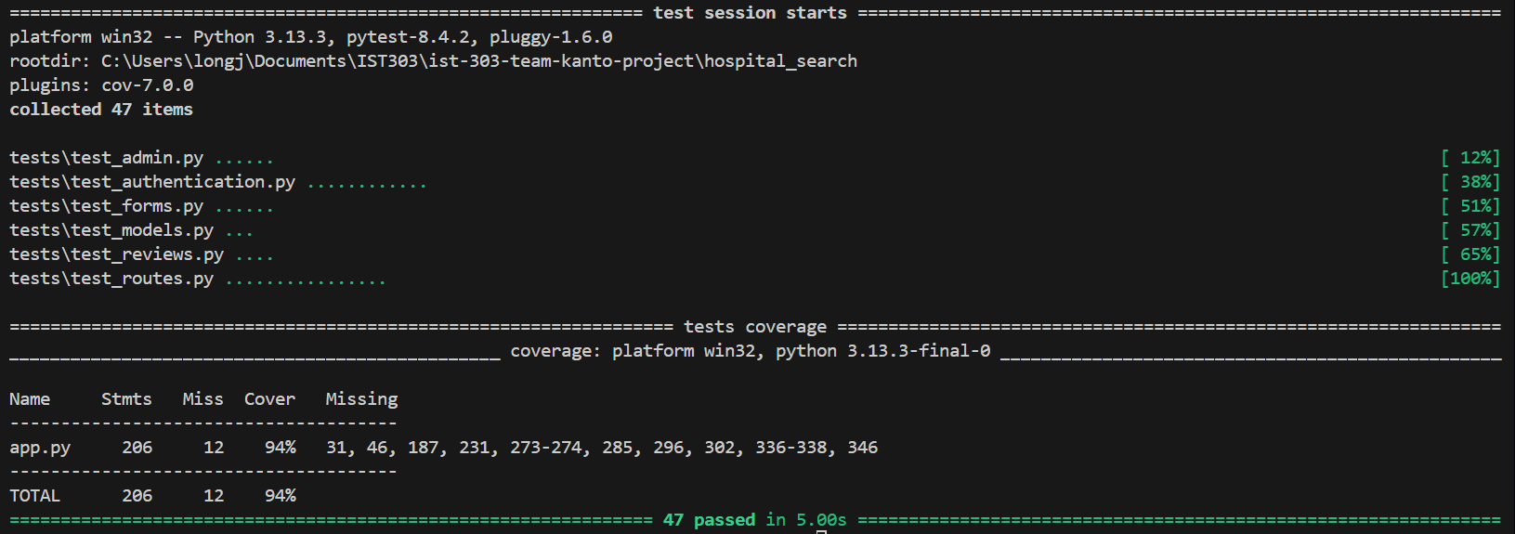
Test Coverage

Slide 13
GitHub Action
Enable GitHub Actions to run pytest on push requests.
- To trigger on push events and run pytest, create a workflow file named actions.yml in .github/workflows/
- https://github.com/davidmertenjones/ist-303-team-kanto-project/blob/main/.github/workflows/actions.yml

Slide 14
Project Plan & Methodology

Slide 15




Milestone 2.0
Iteration 1
AS AN IT ADMIN OR SUPPORT STAFF, I WANT TO MANAGE USER ACCOUNTS AND ASSIGN ROLE-BASED ACCESS TO ENSURE APPROPRIATE PERMISSIONS.
AS A HOSPITAL OR CLINIC ADMINISTRATOR, I WANT TO ADD, UPDATE, OR REMOVE THE THE SERVICES OFFERED BY MY FACILITY SO THAT THE INFORMATION REMAINS ACCURATE AND UP TO DATE FOR USERS.
AS A PATIENT, I WANT TO VIEW AND SUBMIT RATINGS AND FEEDBACK FOR SERVICES I’VE RECEIVED SO I CAN SHARE MY EXPERIENCE WITH OTHER PATIENTS AND PROVIDE INPUT TO THE HOSPITAL FOR IMPROVEMENT.

Slide 16
Key Tasks
Manage user accounts with assigned role-specific access
Only hospital and clinic administrators are allowed to add, update, or remove the services offered by the facilities
Admin can have access to all features in the application
Without logging in, users should be able to submit ratings and feedback for services received
Enable GitHub Action so pytest can be run on pull and push requests
Each feature includes the following tasks:
  UI/UX Design
  Define Acceptance Criteria
  Application Development
  Test Development

Slide 17
Milestone 2.0 Statistics
3 of 3 user stories completed
14 of 14 total tasks completed
15 issues closed, 3 remains open

Slide 18
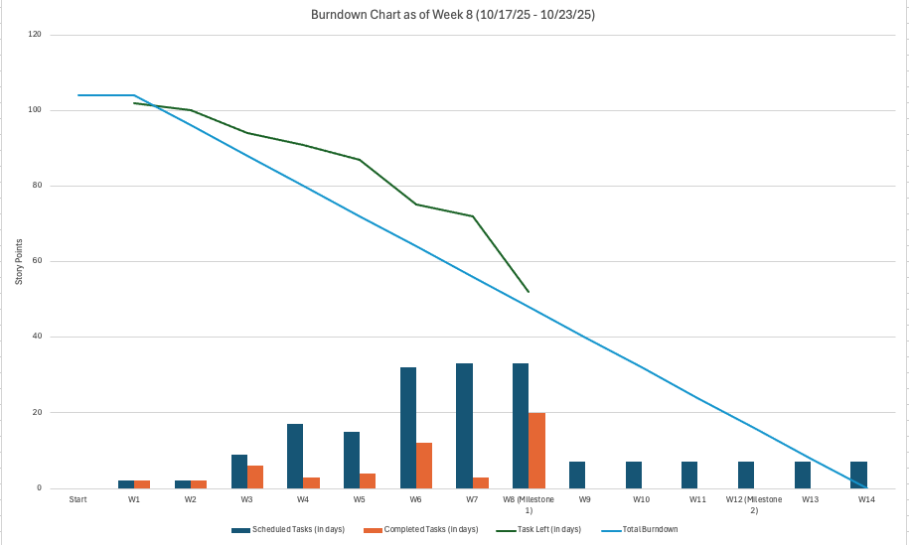
Project Status & Timeline (Week 8)

Slide 19
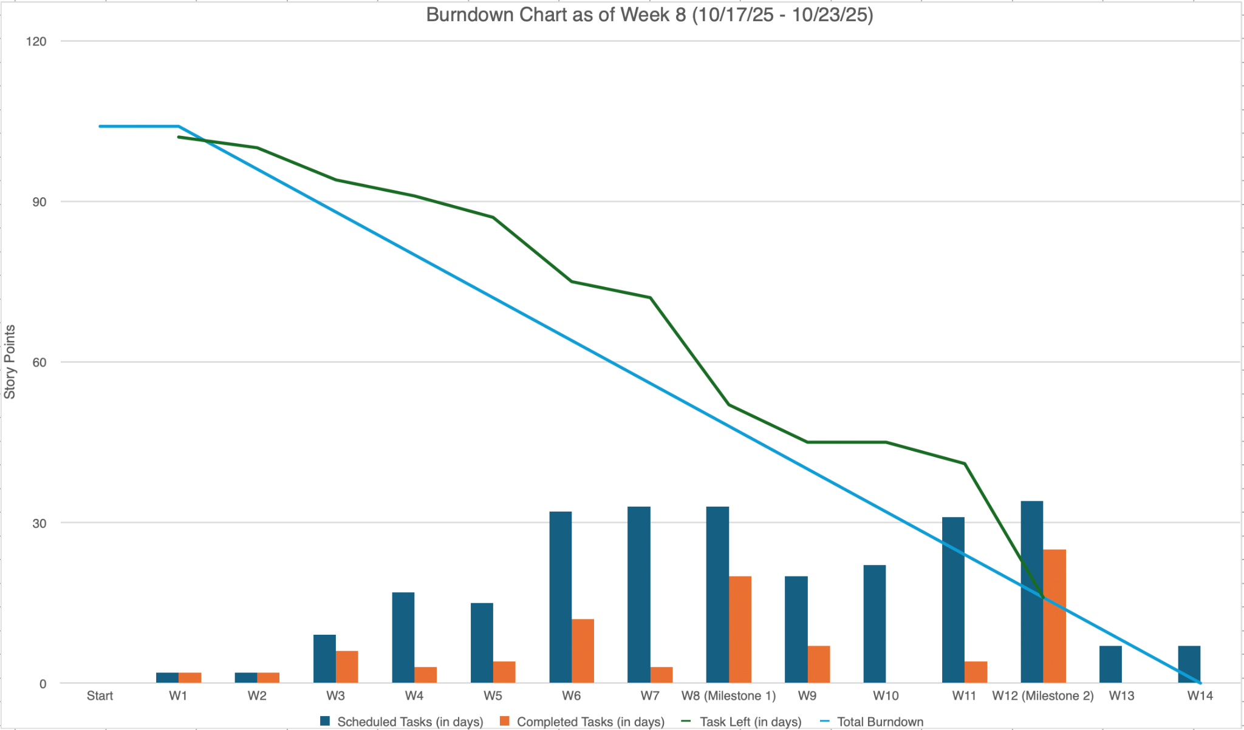
Project Status & Timeline (Week 12)

Slide 20
Team Roles
Eva Mui – Scrum Master
Aishwarya Pandian – Product Owner
David Merten-Jones – Backend Developer
Aashish Sunar – Frontend Developer
Jennifer Long - Designer and Test Engineer

Slide 21
Team Collaboration
Meetings
Status meetings: Tuesdays & Saturdays
Working coordination meeting: Saturdays
Ad-hoc in-person syncs before Thursday class (as needed)
Chat
Microsoft Teams for daily collaboration
Mobile chat group for quick coordination
Documentation & File Sharing
Shared Google Drive for project documents, plans, and deliverables

Slide 22
Team Performance
Milestone: 2.0
Iteration: 2
Time: 4 weeks
User Stories: 3
Velocity: 84.6%

Slide 23
Project Resources
Link to GitHub Repository and README:
https://github.com/davidmertenjones/ist-303-team-kanto-project
Link to Project Dashboard:
https://github.com/users/davidmertenjones/projects/1
Link to issues:
https://github.com/davidmertenjones/ist-303-team-kanto-project/issues

Slide 24
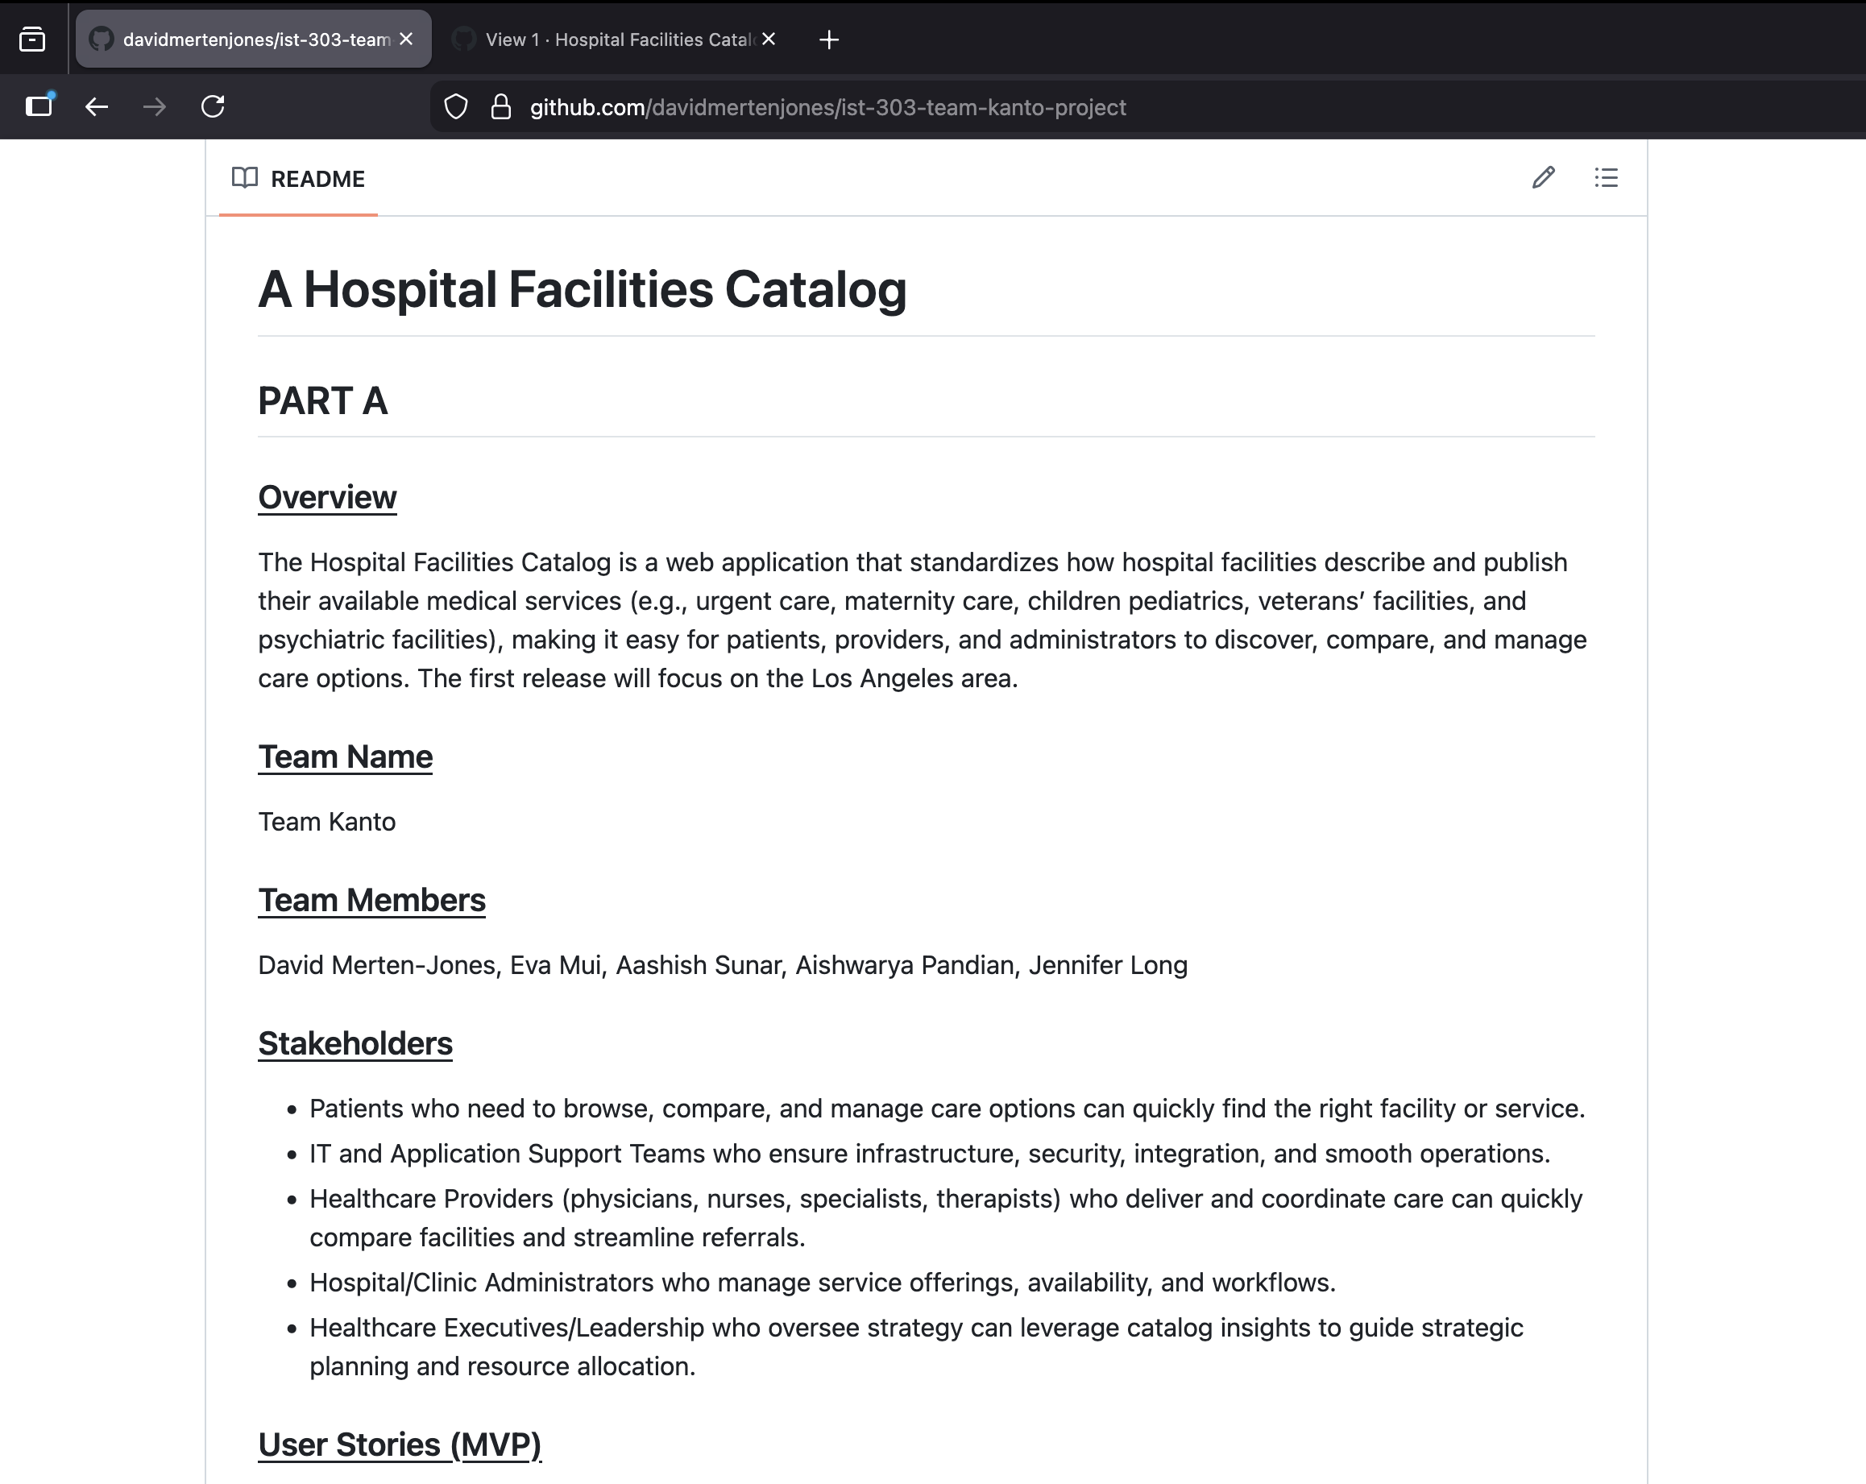
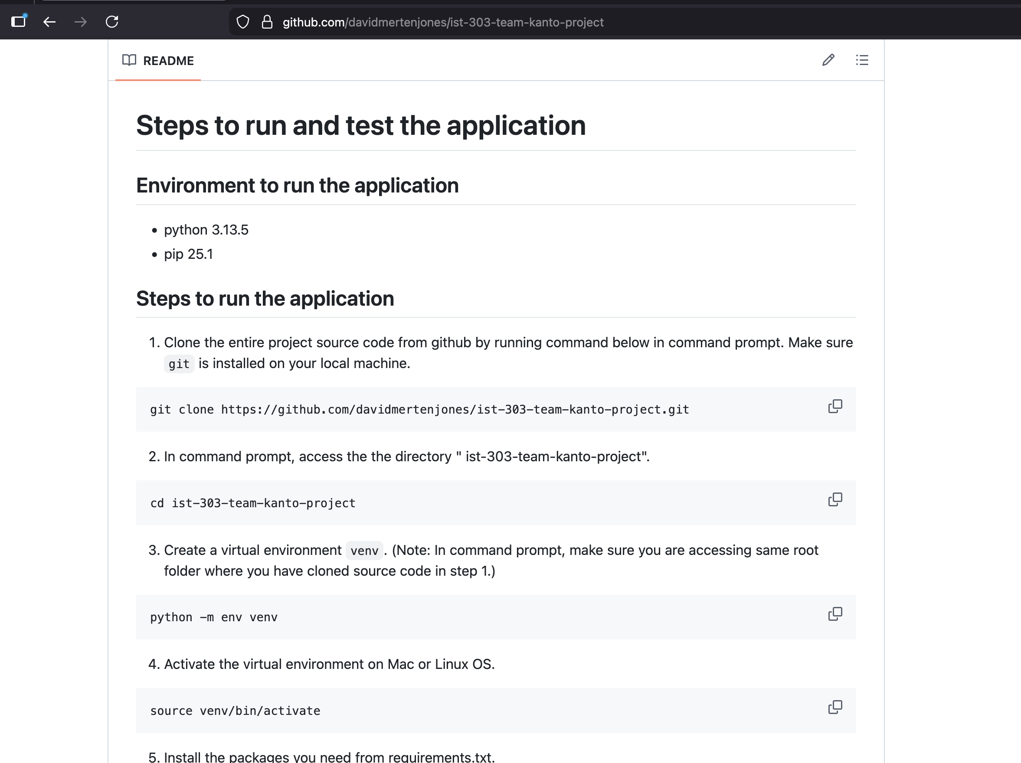
GitHub Repository

Slide 25
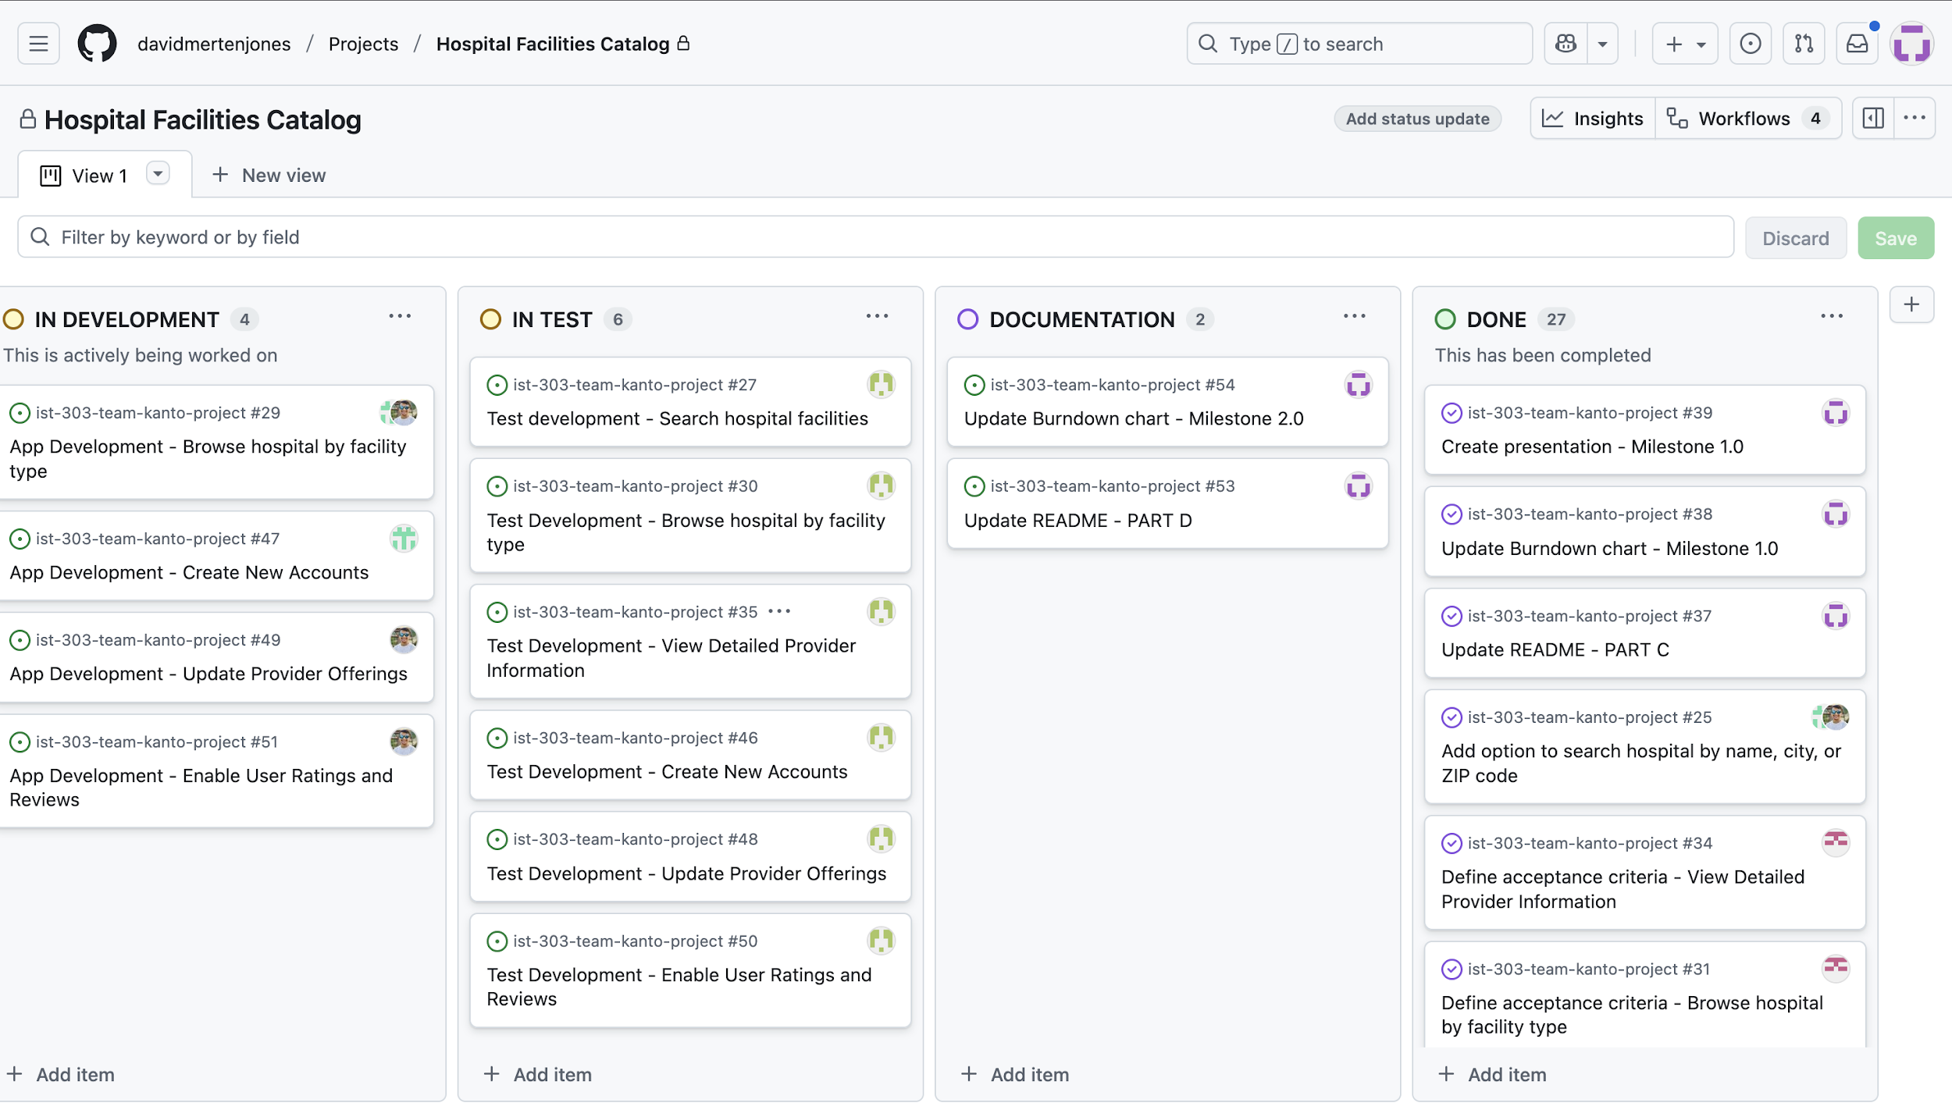
Project Dashboard

Slide 26
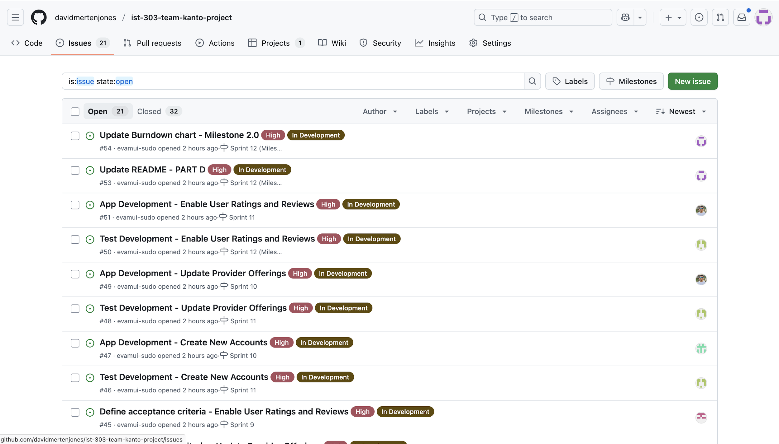
Project Issues

Slide 27
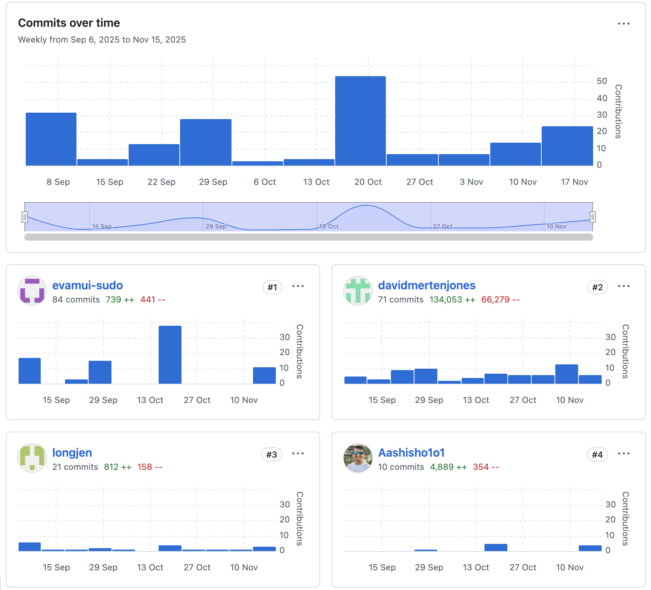
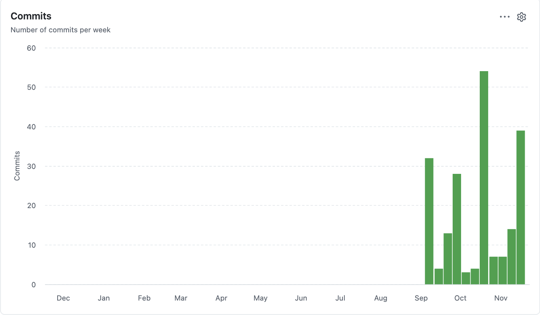
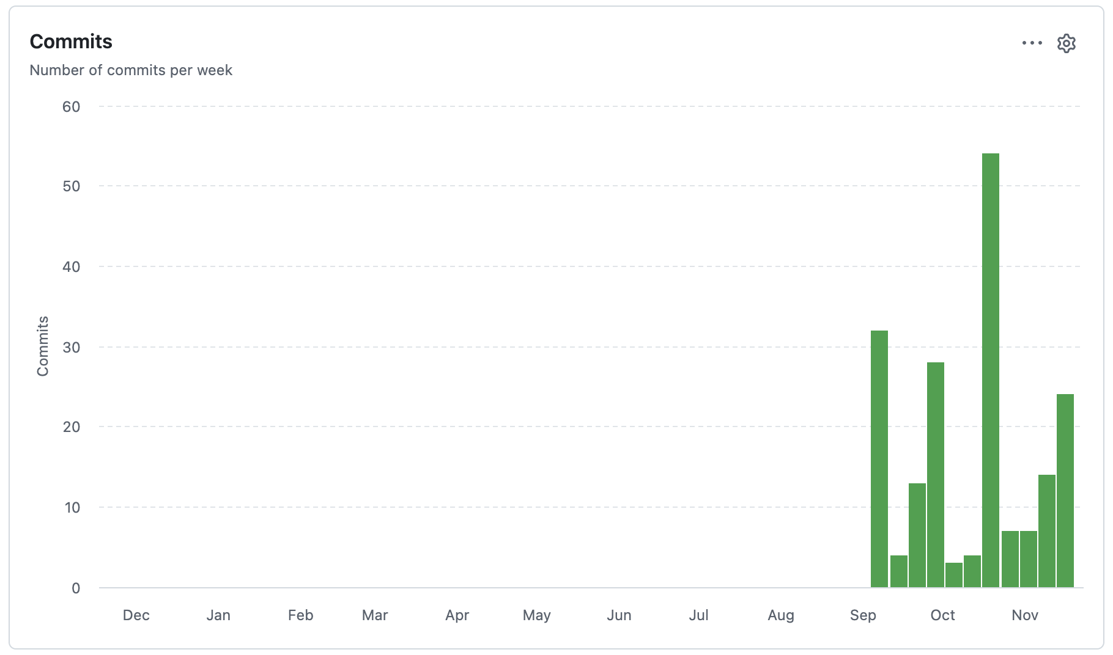
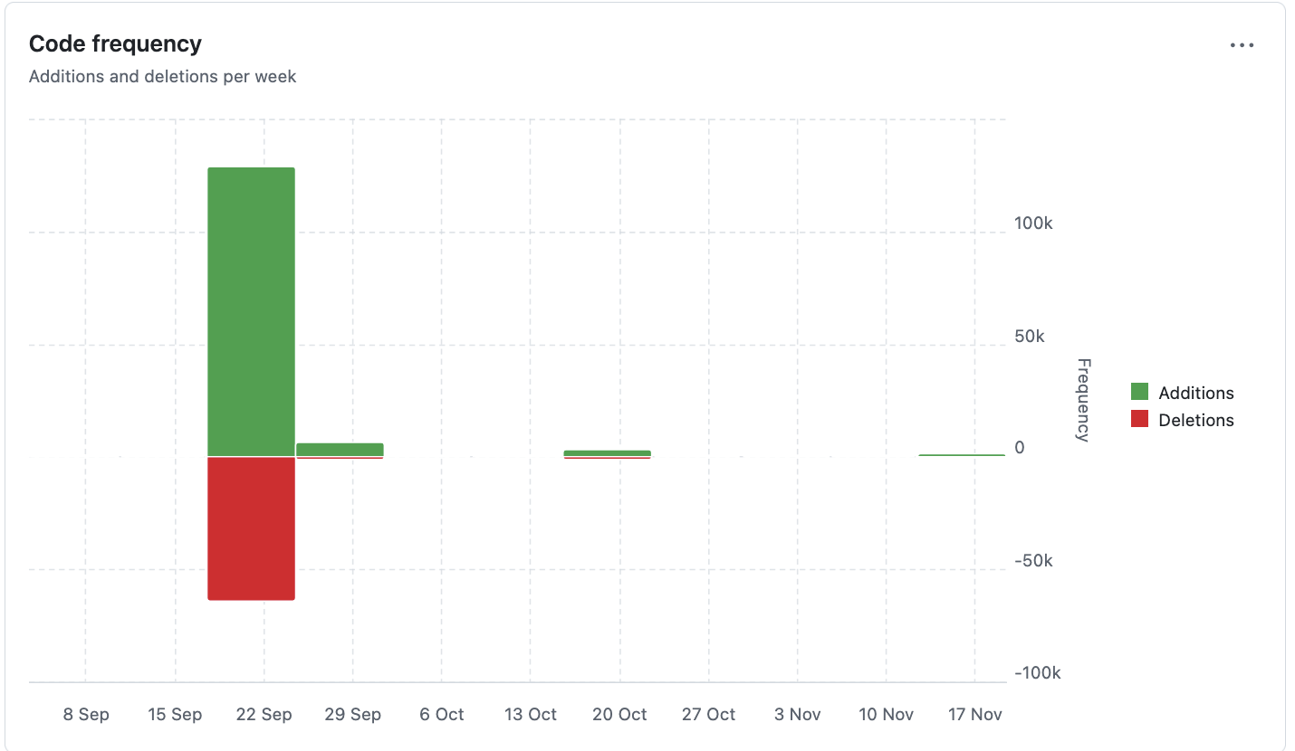
Insights

Slide 28
Lesson Learned

Slide 29
Successes and Failures
Successes | Failures
Implemented lock-out system using flask_security, added three roles with distinct privileges. Users cannot access certain pages unless they have the correct user role. | Could not implement URL generation for hospital details and reviews. Leaps in progress on multiple branches made merges difficult.
Created a page where users can submit the review | Need to add review button close to hospital detail
Allows the admin to make changes to the services provided by hospital | Allow providers to make changes to the services provided by the hospital.
94% test coverage Robust authentication and access control tests | Clean test environment challenges; database context management and isolating tests from each other
Team collaboration succeeded through clear roles, consistent communication, shared deadlines, and a supportive environment. | Scheduling conflicts and ongoing feature updates led to frequent last-minute changes and project delays.

Slide 30
Software Development
Requirements & Plans Evolve
Stakeholder needs and technical realities shift.
User stories and project plans must be continuously refined.
Break Down Big Tasks
Smaller, testable chunks improve clarity, estimation, and momentum while reducing risk.
Collaborate Consistently
Regular team check-ins and shared work sessions improved visibility, caught blockers early, and kept us aligned.

Slide 31
Questions?

Slide 32
References
https://www.digitalocean.com/community/tutorials/how-and-when-to-use-sqlite
Pilone, D., and Miles, R. Head First Software Development. O’Reilly. 2008. 978-0-
596-52735-8. (Available at https://ccl.on.worldcat.org/oclc/213482767)
Lubanovic, B. Introducing Python. O’Reilly. 2015. 978-1-449-35936-2. (Available at
https://ccl.on.worldcat.org/oclc/1127579360)
Okken, B. Python Testing with pytest. The Pragmatic Programmers. 2017. 978-1-
68050-240-4. (Available at https://ccl.on.worldcat.org/oclc/1014021663)

Slide 33
Thank You!

Slide 34
Section header

Slide 35
REPLACE TEXT

Slide 36
Timeline
Add an event
Add an event
Add an event
Write a description of the significance of this event
Write a description of the significance of this event
Write a description of the significance of this event
Add an event
Add an event
Write a description of the significance of this event
Write a description of the significance of this event

